Slide 1
Validating Orbital Trajectory Optimization Problems
William Skamser

Slide 2
Abstract
The research project is to validate Dr. Ossama Abdelkhalik's research group's Low Thrust Orbital Trajectory Optimization solutions with a program called GMAT (General Mission Analysis Tool). Dr. Abdelkhalik's research group has already developed Low Thrust solutions using Matlab and EMTG. The goal is to feed in those solutions into GMAT as an initial guess and optimize them to see if the final result is close to their solutions.

Slide 3
Approach
GMAT does not have a built in method to optimize low thrust problems.
Two approaches have been documented for optimizing low thrust in GMAT
Using API scripts to feed in initial guess and run optimization
Source: An Automatic Medium To High Fidelity Low-Thrust Global Trajectory Tool-Chain
Using the Collocation Stand Alone Library and Toolkit (CSALT) Plugin
Trajectory Optimization plugin designed to solve optimal control problems
The CsaltInterface can support EMTG models to solve low-thrust trajectory optimization
Requires recompiling GMAT from source using SNOPT optimizer and other softwares
Source: GMAT 2020a Release Notes and other documentation included in GMAT download

Slide 4
Timeline of Work
Use tutorials and other online resources to learn the software (Aug 26 - Sep 9)
Research how to use optimizers and feed in initial guess into GMAT (Sep 9- 19)
Attempt recompiling GMAT with SNOPT to build CSALT libraries (Sep 19- Oct 7)
Work on interfacing with MATLAB, API Scripts, and Thrust History Files to feed in initial guess trajectories into GMAT (Oct 7 -Present)

Slide 5
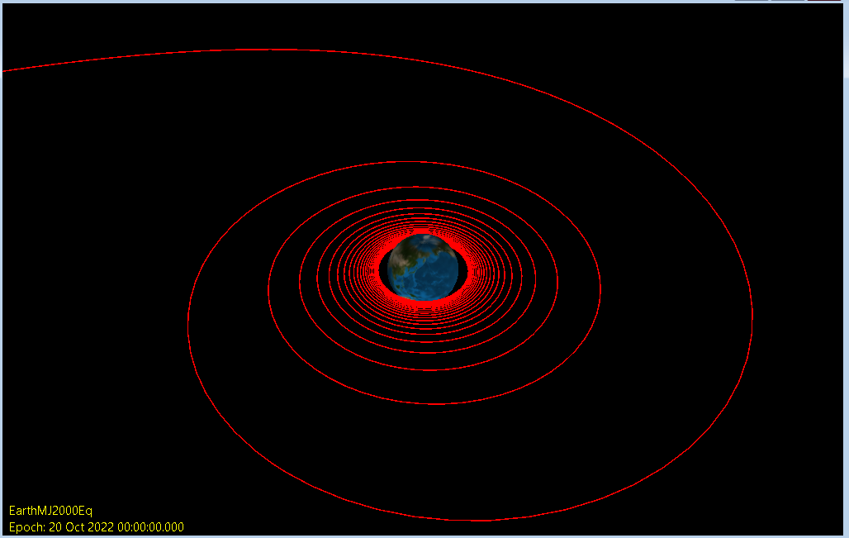
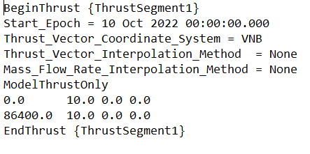
Progress Made
Found a way to read thrust profiles in GMAT
Found a way to interface with Matlab to be able to call Matlab functions into GMAT
Found a way to load in Fmincon and VF13ad optimizers into GMAT
Acquired precompiled SNOPT libraries from UCSD
Continuous 10 N tangential thrust applied in 10 step over 10 days using Thrust History Files (example below)

Slide 6
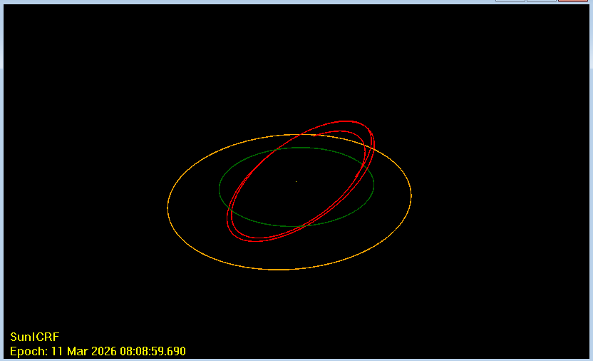
Future Work
Continue developing GMAT-MATLAB-API Interface
Develop Matlab Functions for GMAT
Use Matlab run Optimizers to output Thrust History Files to feed to GMAT
Develop GMAT-Matlab Low Thrust optimizer workflow
Test Optimizing a Low Thrust problem with GMAT
Try recompiling and building GMAT CSALT interface using SNOPT trial libraries
Try if step 1 doesn’t work
Earth to Mars Low Thrust Trajectory I’m currently working on

Slide 7
Report 2 (11/13/22)

Slide 8
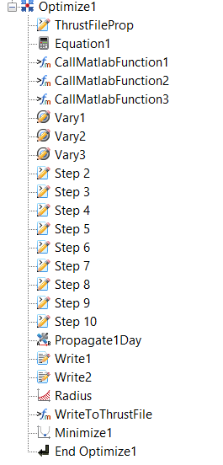
This Month’s Work
This month’s goal was to develop a method to optimize Thrust History files to feed into GMAT.
My first approach was to use GMAT’s built-in optimizing workflow to optimize thrust history files
Unfortunately, GMAT can’t handle optimizing more than a couple of variables → software crashes
My second approach was to run a GMAT script as a propagator within MATLAB using API commands
Example of using GMAT’s build in optimization workflow

Slide 9
Optimization Implementation using MATLAB
The main MATLAB script uses fmincon to optimize the thrust vector profiles used in GMAT
Reads the initial Thrust History file as the initial guess for fmincon
The fmincon objective function calculates the fuel mass consumed
Goal of minimizing fuel consumption
Nonlinear constraints are calculated by running a GMAT script with a modified thrust history file
Rewrites Thrust file
Runs GMAT script
Reads GMAT output file to see if constraints are satisfied

Slide 10
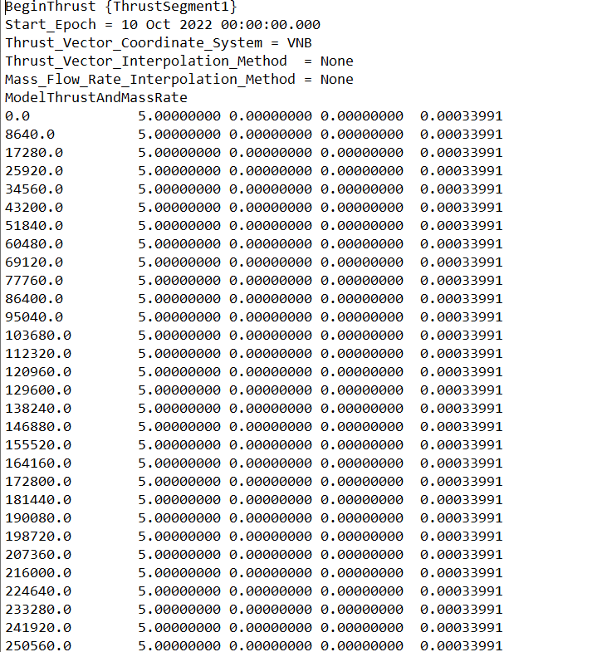
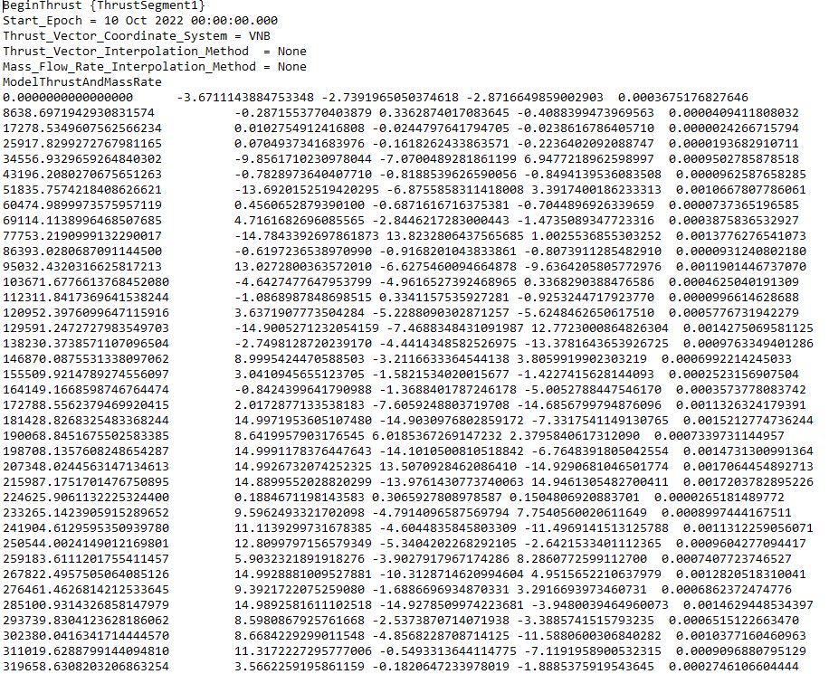
Example of modifying Thrust History file using fmincon
Initial Guess
Modified file to propagate in GMAT

Slide 11
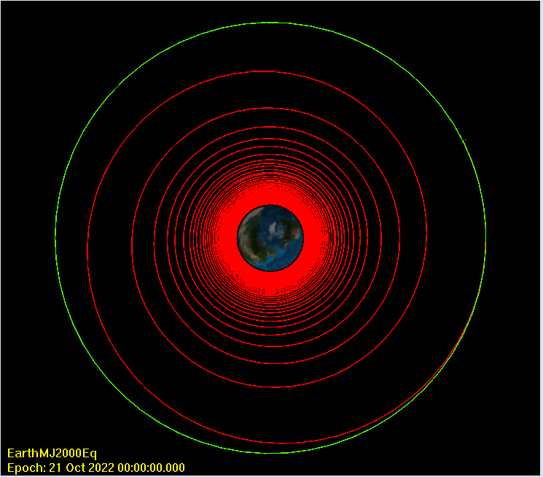
Example used to test and develop this method
Divided into 100 steps within a 10-day window
Bounds of -15 to 15 newtons of thrust per step
Final orbit constraints
Radius of 42,164 km
Eccentricity of 0
Inclination of 0 degrees
Longitude of 93.6465 west
Converge within tolerance
33 iteration
3 hours
Starts from a 7000 km circular LEO orbit → transfer to a GEO orbit

Slide 12
Future work
Try reducing the computation time
Debug common issues that cause GMAT script crashes
Apply this method to validate and optimize existing problems

Slide 13
Report 3 (12/20/22)

Slide 14
Additional features to optimization workflow
Switch optimization design variable to thrust vector angles (in-plane and out- of-plane angles)
Reduce the number of design variables by ⅓
Ability to maintain constant thrust magnitude
Add propagation time as a design variable
Writes the propagation time to a file which is read by a function in GMAT
Add the ability to run optimization on multiple processors
Found a way to interface SNOPT in Matlab

Slide 15
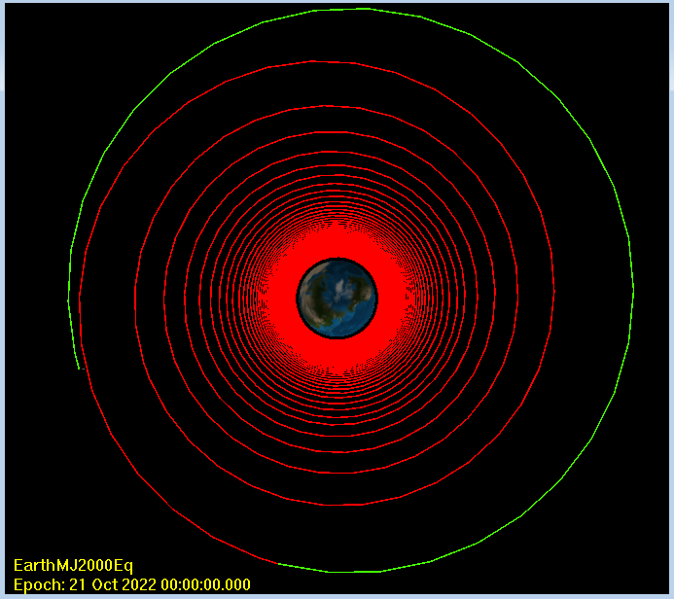
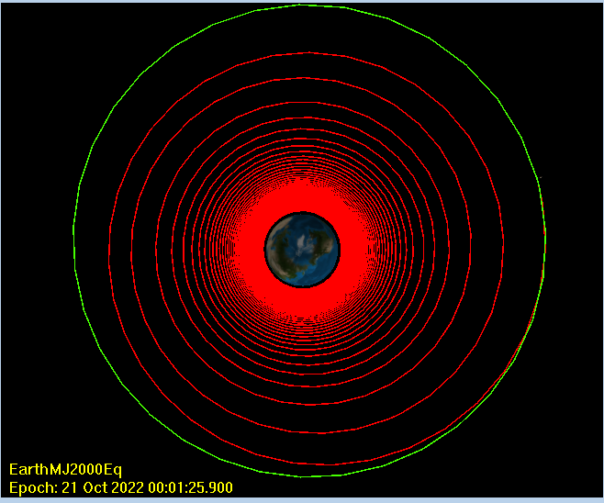
Fmincon vs SNOPT Comparison
Fmincon
Simplified Setup
10 time steps
-11.75 to 11.75 Newton thrust magnitude
Fmincon
Runtime: 10.5 minutes (Converge to infeasible solution)
Iterations: 4
Feasibility: 2.5E+3
Fuel Mass Consumed: 460 kg
SNOPT
Runtime: Over four hours (Manually terminated)
Iterations: 159
Feasibility: 1.2E-4
Fuel Mass Consumed: 420 kg
SNOPT

Slide 16
Future work
Fix issues related to termination criteria and frequent crashes with the SNOPT Matlab interface
Implement SNOPT to solve problems with larger numbers of design variables
Try optimizing the LEO to GEO problem, which has an initial guess with thousands of design variables.
Potential explore other optimization methods that might work better
fmincon/SNOPT (SQP) are 2nd-order methods which require numerical calculation of the gradient and hessian matrix
Extremely computationally expensive to compute gradient from GMAT
Zero-order methods such as the Bisection method may be used to reduce the computation time

Slide 17
Report 4

Slide 18
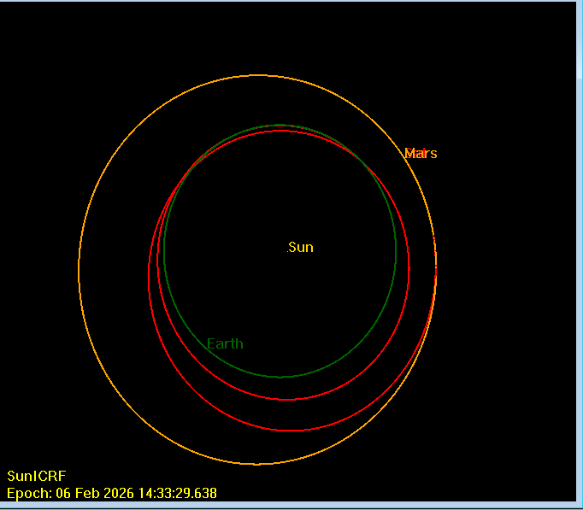
Earth to Mars Problem
Constant 0.1-newton magnitude
3.57e-06 kg/s Mass flow rate
Fuel Mass 1000 kg
Fuel Consumption 287.8 kg
Fixed Started date: July 20, 2023
End date: February 06, 2026
Time of Flight: 933 days
Total number of steps: 200
Number of Major iterations: 265
Total interactions: 7093
Total run time: 13 hours
Feasibility: 6.5E-09
Optimality: 8.0E-07
Earth to Mars Trajectory (Red)

Slide 19
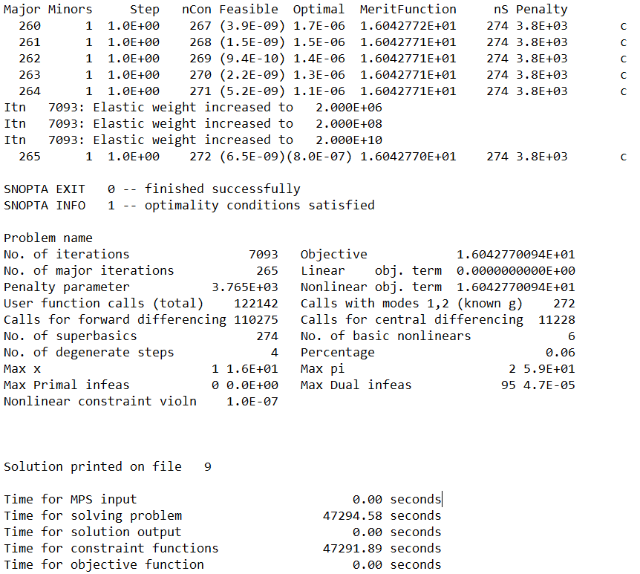
Earth to Mars SNOPT Optimization Setup
Objective Function: Time of Flight
Constraints: Spacecraft’s relative position and velocity to Mars
Load initial guess
alpha, beta thrust vector angles, and TOF
Set design variable and function bounds
-pi to +pi thrust angle, ½ year to 10 year TOF
ObjFun: 0 to 10 years, constraints equal 0
Run SNOPT optimization
Calls Objective/Constraint Function
Converts design variable into thrust file and updates GMAT propagation time
Run GMAT and extract Spacecraft data with API commands
Calculated Spacecraft’s relative position and velocity to Mars Ephemeris data
Compute objective function and constraints
SNOPT Output Summary

Slide 20
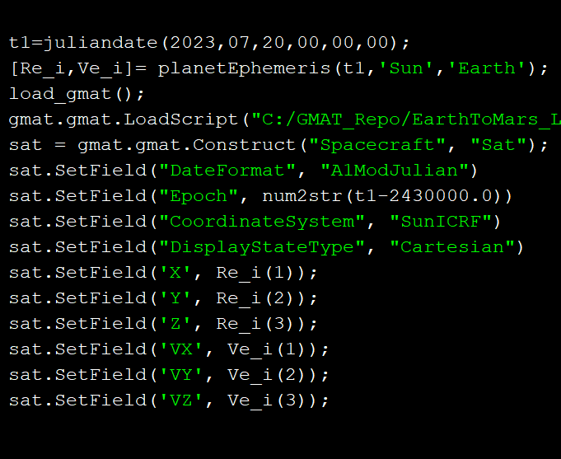
Future Work
Search for more optimal solutions
Increase Step Size
Make start time a design variable
Modify start time through API commands
Have MATLAB-SNOPT-GMAT code working on Linux HPC-cluster to be able to run longer simulations remotely
Get a compiled version of GMAT in Linux
Apply this method to other problems
API Commands to set start time, initial position, and velocity of spacecraft in GMAT

Slide 21
Report 5

Slide 22
MATLAB-SNOPT-GMAT Generalized Solver Function
The goal is to create a function that would generate a GMAT script and optimize the thrust trajectory for any given low-thrust problem
Takes an initial guess for the thrust trajectory and a set of input options from the user, then generates a GMAT script
Using API commands, the function is able to configure and run GMAT script for any low-thrust rendezvous problems
Outline of what the function does
Read initial thrust trajectory and input options
Configure GMAT Script for given input options
Run SNOPT Optimizer (Or with the option to run function without optimizing input)
Configure GMAT Plot Script with trajectory solution for visualization
Drawback: SNOPT Optimization in MATLAB still takes several hours

Slide 23
A Second Optimization Approach (CSALT Plugin for GMAT)
CSALT is a GMAT plugin that can be used to optimize low thrust problems within the software. However, it requires compiling GMAT from the source code with SNOPT and other dependencies.
Link to paper on CSALT: https://ntrs.nasa.gov/api/citations/20170003690/downloads/20170003690.pdf
However, the compiling process described here doesn’t seem to fully work.
The configure script used in step 2 of compiling process is out of date (fails to download dependencies).
I was able to manually download the dependencies and modify the script to fix these issues
However, in the build process (step 3), CMake is not recognizing the SNOPT libraries (snopt7.dll, and snopt7_cpp.dll) that I have compiled.
I have sent emails to GMAT’s software support and to GMAT forums, but have not received a reply yet from the developers

Slide 24
Future Work
Finish MATLAB-SNOPT-GMAT Generalized Solver Function
Mostly done at the moment
Will need time to test on example problems and debug any issues
Add more options and features to function if necessary
Finish Compiling CSALT Plugin
Try fixing issues with compiling process
Replace the SNOPT optimizer in the Generalized GMAT solver with CSALT optimizer in GMAT
Would run significantly faster
Develop a similar function for EMTG (another trajectory optimization software)
Python function to automate the process of setting up and running problems in EMTG

Slide 25
Report 6

Slide 26
Progress on finalizing GMAT Low-Thrust Solving Function
Reduce the solver function to two files
Standardized input options for the function
Provide the option to run with or without optimization
Option to optimize for minimizing time of flight
Option to optimize for only achieving constraints
Added supporting functions
Function to interpolate input data to increase or decrease the number of steps
Function that rewrites solver’s input Excel sheet
Function that interprets design variable vector if SNOPT optimization is paused or prematurely terminated

Slide 27
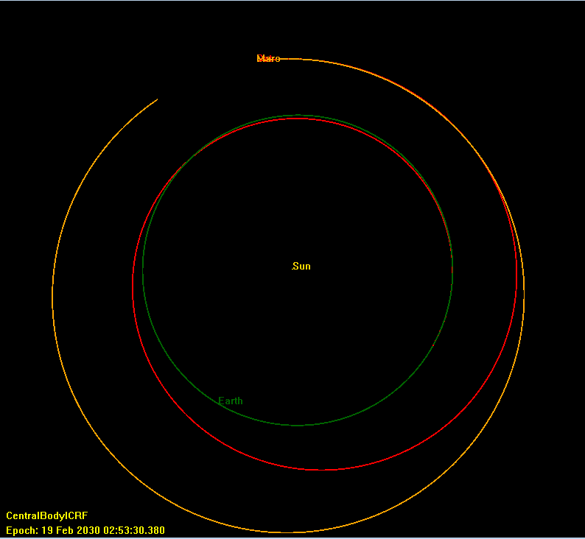
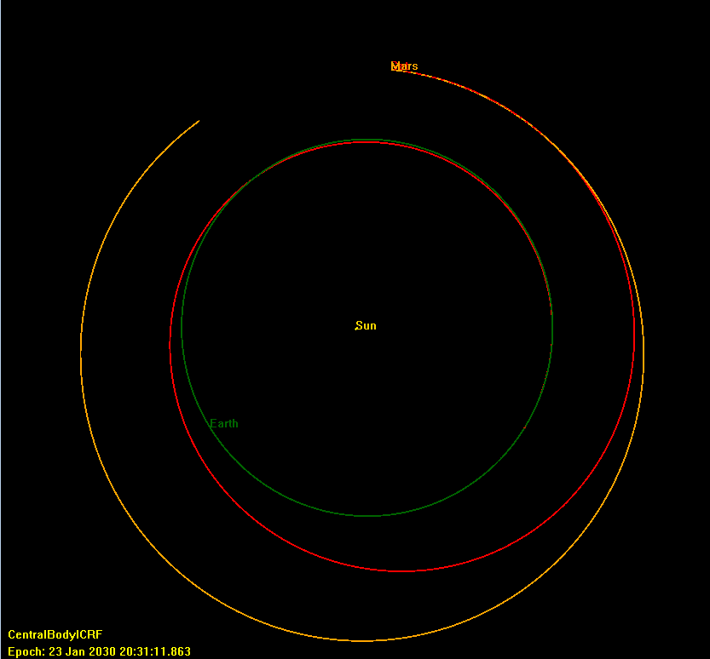
Number of Time Steps Comparison (Earth To Mars FFS problem ran for 1000 iterations)
Feasible 6.7E-06
Optimal 1.4E+00
50 Steps
Feasible 6.0E-06
Optimal 5.6E-01
200 Steps
Run Time 11.5 hr
Run Time 5.2 hr

Slide 28
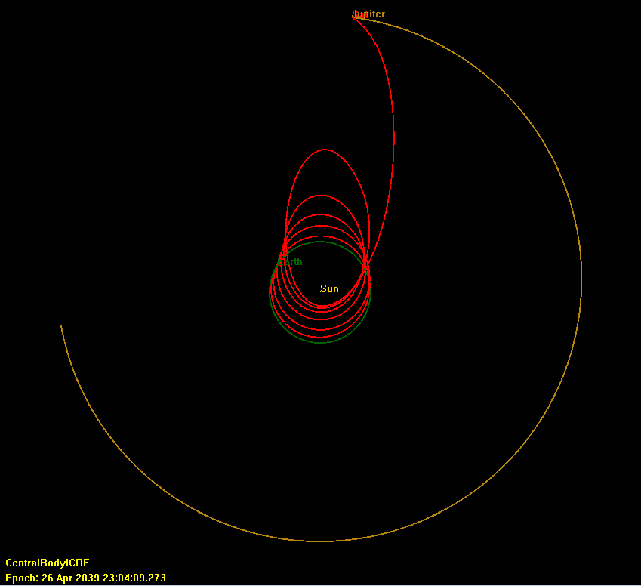
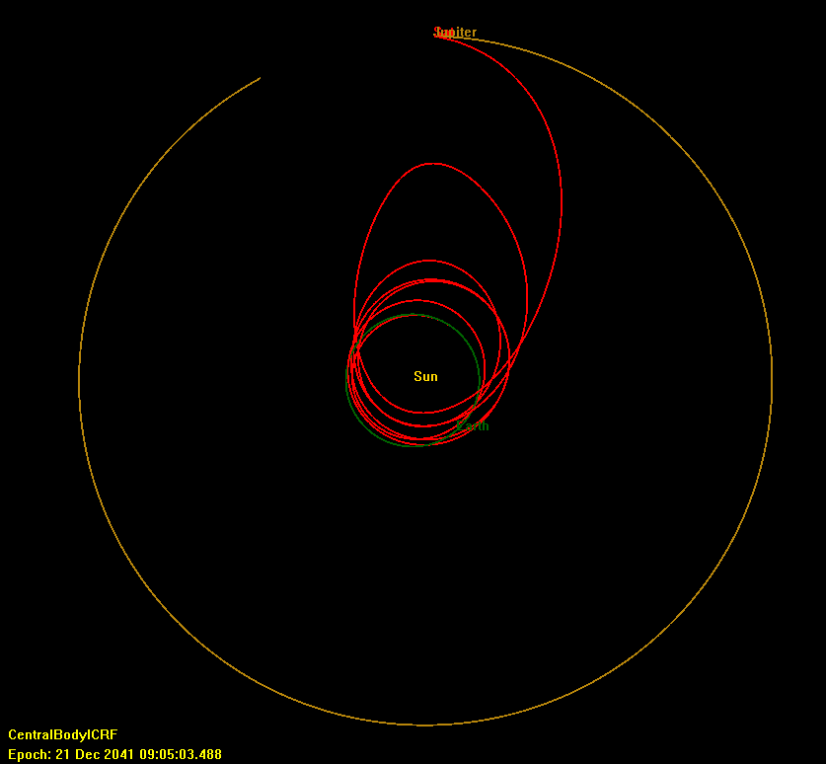
Number of Time Steps Comparison (Earth To Jupiter FFS problem) (unconverged solution)
300 Steps
Feasible 2.6E-01
Optimal 1.6E+00
50 Steps
Feasible 7.9E-02
Optimal 1.3E-01
Run Time 24 hr
Run Time 6 hr

Slide 29
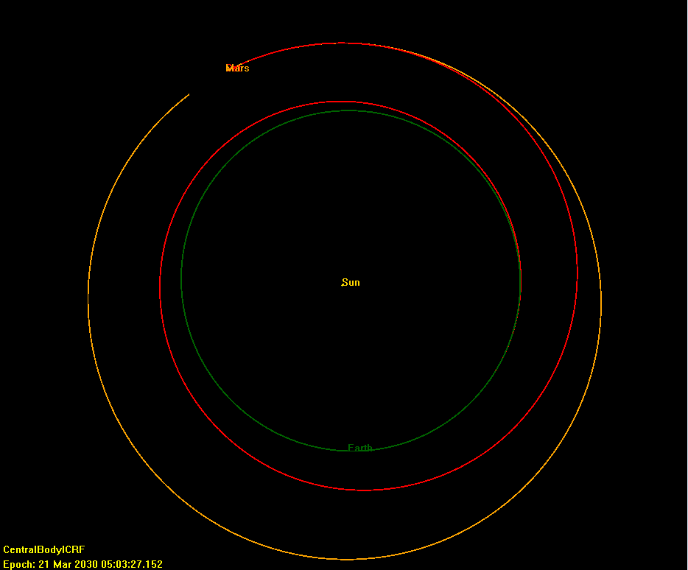
Running without Time of Flight Objective Function (Mars Problem)
50 Steps
Only minimize the constraints
Run Time 55 minutes
Significant run time reduction
Used as Initial guess for TOF optimization problem which only took an additional 2 hours to converge
Norm of difference in final state vector: 3.3165512E-06

Slide 30
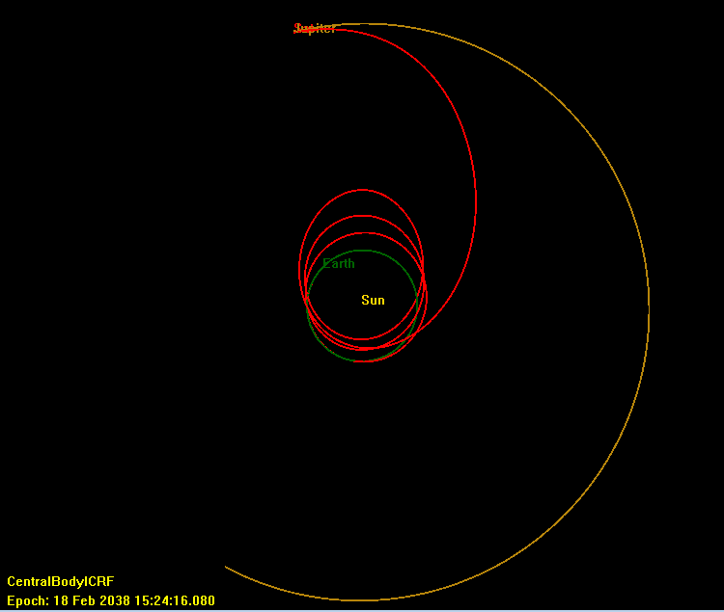
Running without Time of Flight Objective Function (Jupiter Problem)
50 Steps
Smaller TOF than solutions where TOF was the objective function
Run Time 16 hours
Prematurely terminated before finishing
Norm of difference in final state vector: 2.6069424E-02

Slide 31
Next Steps
Try optimizing other low-thrust problems
Confirm that the solver works on other computers
Write a final report presentation for this research project
Continue working on compiling the CSALT plugin
Hopefully, the optimization sequence can be replaced by whoever works on this project in the future.

